Slide 1

By Annah Mokalapa
BRIGHT TV VIEWERSHIP

Slide 2

Home
About
Contact
USER TREND ANALYSIS
Age Demographics
Race % Participation
Province Participation
Gender participation

Slide 3

AGE DEMOGRAPHICS
56%
States that Adults Aged 36 - 55 contribute the most in terms of viewership
Make Data
38% of the Segmentation is SPORTS

Slide 4
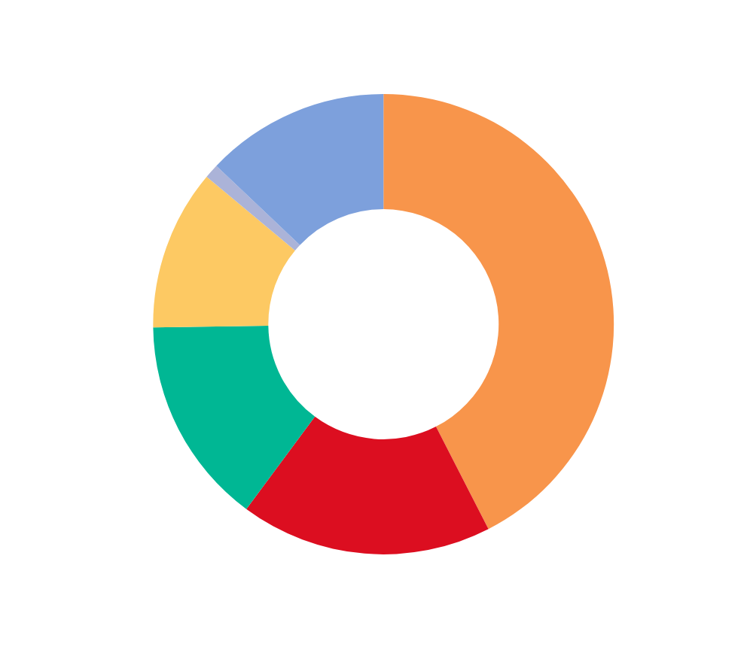
Home
About
Contact
“RACE” DEMOGRAPHICS
African viewer contributes 42.5%
Top 3 segmentation is Sports, Music and Entertainment , Sports leading the segementation by 26%

Slide 5

PROVINCE % SEGMENTATION
35%
Gauteng Leading Viewership
Make Data
SPORTS AT 39.56%
MUSIC AT 18.97%
CARTOONS AT 14.97%

Slide 6


INTERESTING FACTS
Most Viewed Channel is
“Super Sports Live Events “ Watched at Afternoon Events

Slide 7

LEAST CHANNEL VIEWED
Its Sad to say but the Bottom 3 :
Live on SuperSport at 0.02%
Wimbledon at 0.03%
MK Channnel 0.3%

Slide 8
VIEWERSHIP TREND & HABITS
Popular viewer Time
Viewers Tune in and watch sports in the Morning Between 07:00 - 11:59
Duration Hours
26% of that segment is in the Morning Hours for a total of 2679 Hours

Slide 9

CONCLUSION
What did we Learn?
Sports channels especially “SuperSport Live Events should be heavily marketed
Its seems that the viewers like watching sport during the Morning and or Afternoon events.

Slide 10
Home
About
Contact
See You Next
THANK YOU
2024 Data Analysis Presentation

